Slide 1
Locality-sensitive hashing of curves
Iman Hosseini

Slide 2
Anne Driemel and Francesco Silvestri 1 Department of Mathematics and Computer Science, Eindhoven University of Technology, The Netherlands adriemel@tue.nl 2 Department of Information Engineering, University of Padova, Italy Theoretical Computer Science, IT University of Copenhagen, Denmark silvestri@dei.unipd.it
------------------------------------------------------------------------------------------------------------------------------------------------------
Proc. of 33rd International Symposium on Computational Geometry (SoCG), 2017

Slide 3
What is it about?
data structures for storing a set of polygonal curves in IRd such that, given a query curve, we can efficiently retrieve similar curves from the set, where similarity is measured using the discrete Fréchet distance or the dynamic time warping distance.

Slide 4
What is it about?
Let n be the number of input curves and let m be the maximum complexity of a curve in the input. In the particular case where m ≤ (α/4d) log n, for some fixed α > 0, our solutions imply an approximate near-neighbor data structure for the discrete Fréchet distance that uses space in O(n^{1+α} log n) and achieves query time in O(n^{α} log² n) and constant approximation factor.

Slide 5
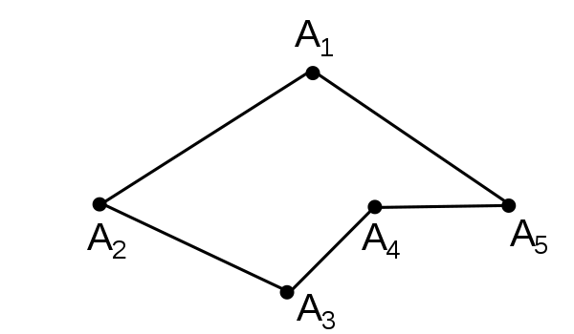
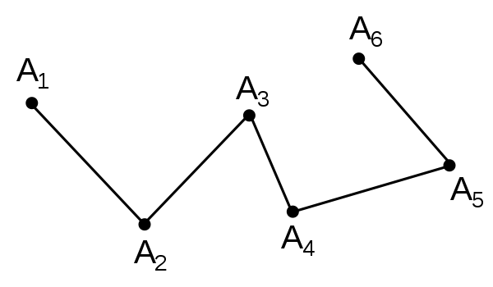
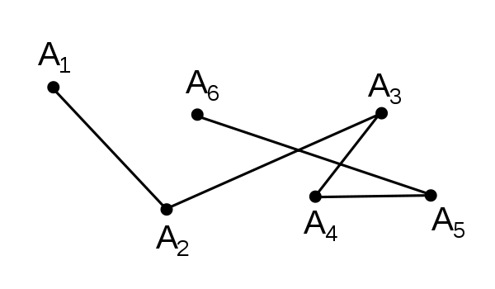
Similar Polygonal Curves

Slide 6
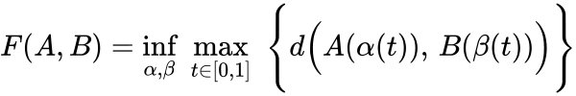
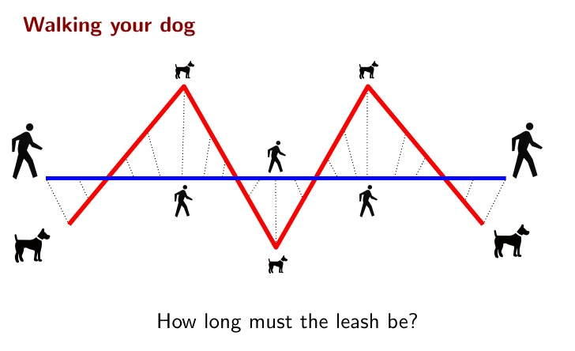
Fréchet Distance (Dogwalking) –
handwriting recognition to protein structure alignment

Slide 7

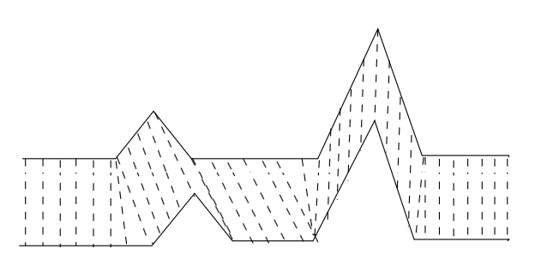
Dynamic Time Warping Distance (DTW)
whale singing, chromosomes, fingerprints, electrocardiogram (ECG) frames

Slide 8
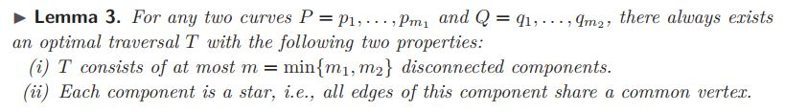
The discrete Fréchet distance satisfies the triangle inequality and is a pseudo-metric. This is not true for the DTW distance, since it does not satisfy the triangle inequality .
Pseudo-metric : Like a metric BUT d(X,Y) can be zero for X≠Y
In the group of ℓp distances, the Fréchet distance most resembles the ℓ∞-distance, which is notoriously hard to embed into a low-dimensional ℓp-space

Slide 9
Other work
Recently, Backurs and Sidiropoulos showed how to embed finite subsets of the Hausdorff distance into ℓ∞ using constant distortion and constant dimension of the host space
In general, there is little known in terms of data structures for the Fréchet distance.
Unlike the ℓ∞-metric, which can be evaluated in time that is linear in the dimension, evaluating a single Fréchet distance is believed to take time that is at least roughly quadratic in the complexity of the curves (the number of vertices) in the worst case

Slide 10
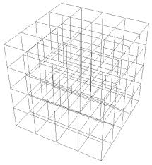
Snapping to grid
G_{δ} = {(x1, . . . , xd) ∈ IR^{d} | ∀ 1 ≤ i ≤ d ∃ j ∈ IN : x_{i} = j · δ }
t picked uniformly from [0, δ)^{d}

Slide 11
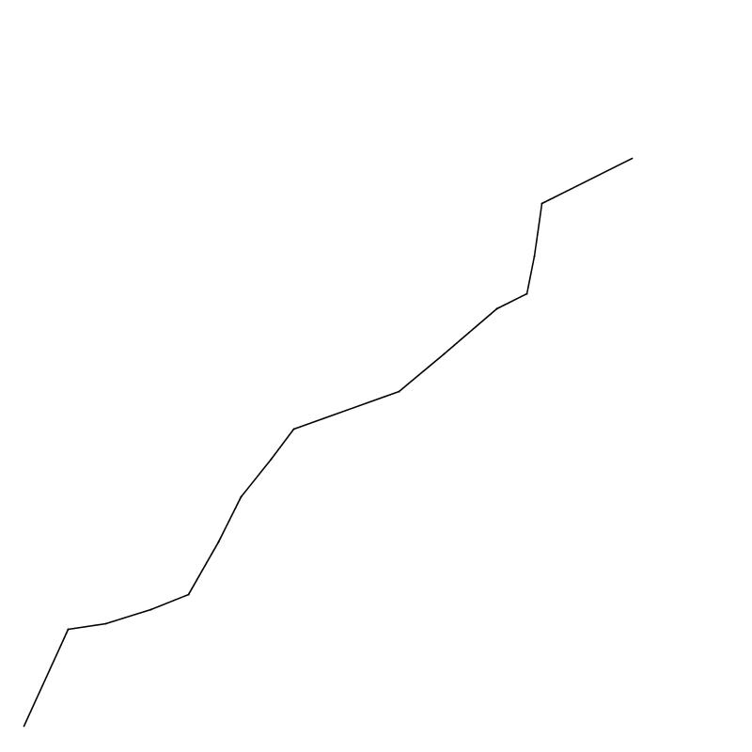

Slide 12
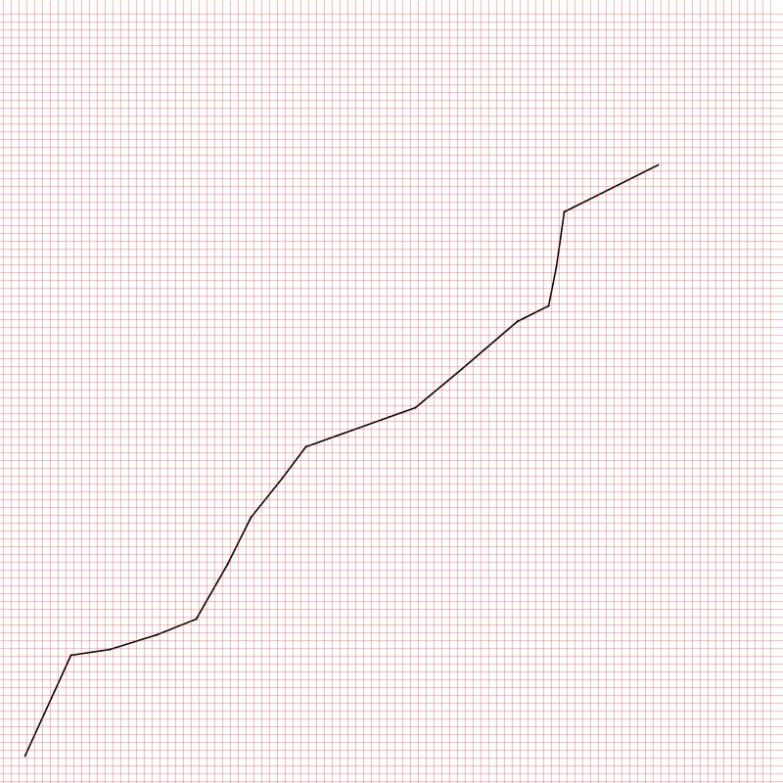

Slide 13
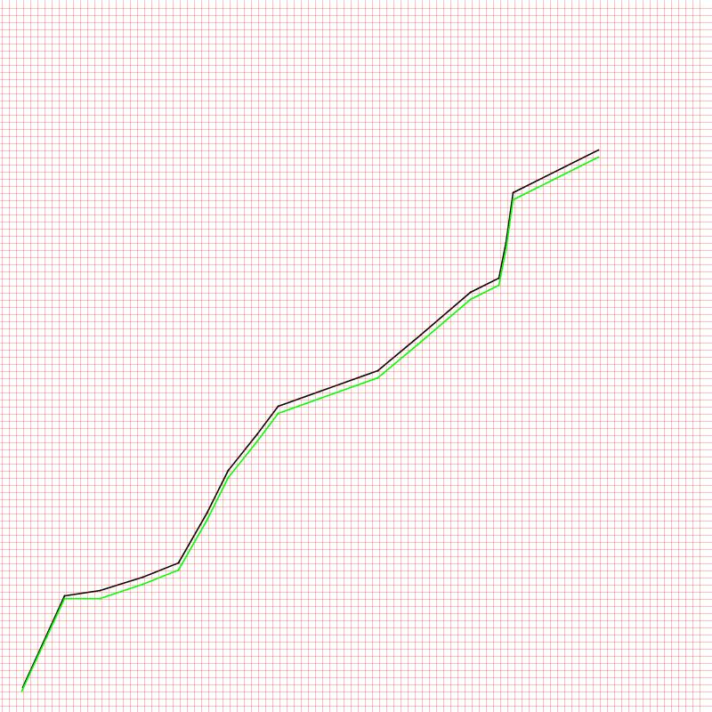

Slide 14
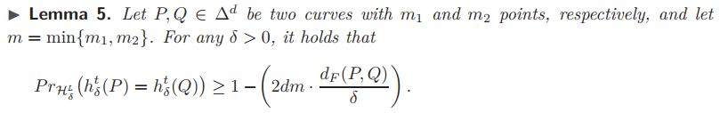
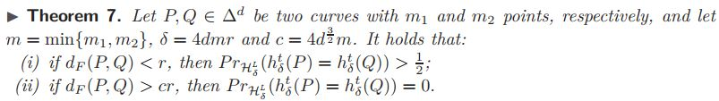

Slide 15
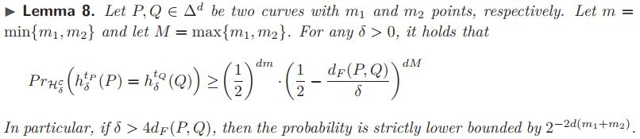
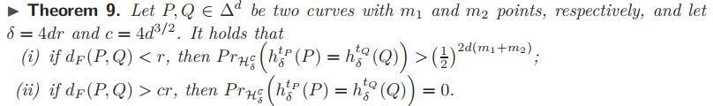
A sequence t_{P} = (t₁,t₂,..,t_{m}) => More trials Better convergence

Slide 16
Trade-off between approximation factor and query time The basic idea is to randomly partition the input curves and to concatenate the outcome of the basic LSH applied to the different parts of the curves.

Slide 17
Incorporating Constraints partitioning (Again): A traversal T is said w-anchored traversal if each vertex is paired with a vertex at distance at most w/2. A traversal T is a w-speed traversal if each vertex is aligned with at most w vertices of the other curve: in other terms, the bipartite graph representing the traversal has degree at most w.

Slide 18
https://github.com/ImanHosseini/LSH
Simple implementation in Java
And the slides

